Slide 1
Code Refactoring
&
Code Smell
Chapter 16 & 17-Clean Code

Slide 2

What is Refactoring?
“Refactoring is a change made to the internal structure of software to make it easier to understand and cheaper to modify without changing its observable behavior.”
- Martin Fowler
Refactoring is a systematic process of improving code without creating new functionality that can transform a mess into clean code and simple design

Slide 3


The Two Hats
Two distinct activities
adding functions
refactoring
These two activities should NOT take place at the same time

Slide 4
Goals
Prevent code quality reduction
Make code clear
Help to find bugs
Help to program faster

Slide 5
Clean Code and Dirty Code
Dirty Code
Dirty code is result of inexperience multiplied by tight deadlines, mismanagement, and nasty shortcuts taken during the development process.
Clean Code
Clean code is code that is easy to read, understand and maintain. Clean code makes software development predictable and increases the quality of a resulting product

Slide 6

When to Refactor
The Rule of Three
Three strikes and you refactor
You do something the first time
You do similar thing again with regret
On the third time – start refactoring
It states that two instances of similar code don’t require refactoring, but when similar code is used three times, it should be extracted.

Slide 7
When to Refactor
When adding new functionality
understanding the code
prepare code for adding new functionality
When fixing a bug
error is a sign for refactoring
Code reviews
Notes:
Bugs in code behave just like those in real life: they live in the darkest, dirtiest places in the code. Clean your code and the errors will practically discover themselves.
Managers appreciate proactive refactoring as it eliminates the need for special refactoring tasks later. Happy bosses make happy programmers!

Slide 8
Purpose
The main purpose of refactoring is to fight technical debt. It transforms a mess into clean code and simple design.
Notes:
Everyone does their best to write excellent code from scratch. There probably isn’t a programmer out there who intentionally writes unclean code to the detriment of the project. But at what point does clean code become unclean?
The metaphor of “technical debt” in regards to unclean code was originally suggested by Ward Cunningham.
If you get a loan from a bank, this allows you to make purchases faster. You pay extra for expediting the process - you don’t just pay off the principal, but also the additional interest on the loan. Needless to say, you can even rack up so much interest that the amount of interest exceeds your total income, making full repayment impossible.
The same thing can happen with code. You can temporarily speed up without writing tests for new features, but this will gradually slow your progress every day until you eventually pay off the debt by writing tests.

Slide 9
When You Shouldn’t Refactor
Resources:The resource mentioned most often was time, as in "Deadlines often don't allow refactorings"; "Sometimes there is just no time"; and "No time no time.“
Risk:"That kind of refactoring is time consuming and there is a large risk of introducing bugs" and "If it's working I leave it alone.“
Difficulty: Another concern was the difficulty in making the change, as in "Inheritance is tricky to refactor correctly" and "This kind of refactoring is usually difficult.
ROI : "Again, I have to weigh the costs and benefits. The benefits have to be clear before taking on the costs of refactoring,
Notes:
Depr
Resources:Concern over the resources required was a frequently cited reason for not refactoring. The resource mentioned most often was time, as in "Deadlines often don't allow refactorings"; "Sometimes there is just no time"; and "No time no time."
Risk:Also frequently cited was the risk involved in making a change, in particular introducing new faults or other problems, as in "That kind of refactoring is time consuming and there is a large risk of introducing bugs" and "If it's working I leave it alone."
Difficulty: Another concern was the difficulty in making the change, as in "Inheritance is tricky to refactor correctly" and "This kind of refactoring is usually difficult."
ROI : Participants acknowledged that while there may be benefits from refactoring, there are also costs, and the return on investment, or ROI, has to be considered, as in "Again, I have to weigh the costs and benefits. The benefits have to be clear before taking on the costs of refactoring,
eciate = diminish in value over a period of time.

Slide 10


When You Shouldn’t Refactor
Low code quality
easier rewrite than refactor
code should work correctly before refactoring
Deadline is too close
postpone refactoring = technical debt

Slide 11
Smelling Code
Signs of low quality code

Slide 12
Code Smell
Code smells are indicators of problems that can be addressed during refactoring.
Code smells are easy to spot and fix, but they may be just symptoms of a deeper problem with code.
Code smell refers to any symptom in the source code of a program that possibly indicates a deeper problem.

Slide 13
Types
Bloaters
Object Orientation Abusers
Change Preventers
Dispensable
Couplers
Notes:
Bloaters
Bloaters are code, methods and classes that have increased to such gargantuan proportions that they are hard to work with
Object-Orientation Abusers
All these smells are incomplete or incorrect application of object-oriented programming principles.
Change Preventers
These smells mean that if you need to change something in one place in your code, you have to make many changes in other places too. Program development becomes much more complicated and expensive as a result
Dispensables
A dispensable is something pointless and unneeded whose absence would make the code cleaner, more efficient and easier to understand.
Couplers
All the smells in this group contribute to excessive coupling between classes or show what happens if coupling is replaced by excessive delegation.

Slide 14
Types
Types
Bloaters are code, methods and classes that have increased to such huge proportions that they are hard to work with.
Object Orientation Abusers are incomplete or incorrect application of object-oriented programming principles.
Change Preventers smells mean that if you need to change something in one place in your code, you have to make many changes in other places too. Program development becomes much more complicated and expensive as a result

Slide 15
Types
A dispensable is something pointless and unneeded whose absence would make the code cleaner, more efficient and easier to understand.
Coupler smells in this group contribute to excessive coupling between classes or show what happens if coupling is replaced by excessive delegation.

Slide 16
Code Duplication
The same code structure appears in multiple places.
Two code fragments look almost identical.
Duplication usually occurs when multiple programmers are working on different parts of the same program at the same time.
Reason Since they’re working on different tasks, they may be unaware their colleague has already written similar code that could be repurposed for their own needs.
Notes:
Dispensables
A dispensable is something pointless and unneeded whose absence would make the code cleaner, more efficient and easier to understand.

Slide 17
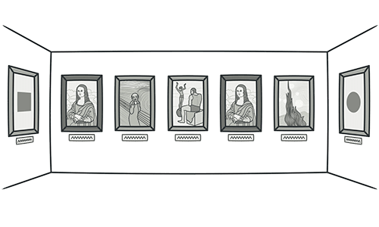
Code Duplication

Slide 18
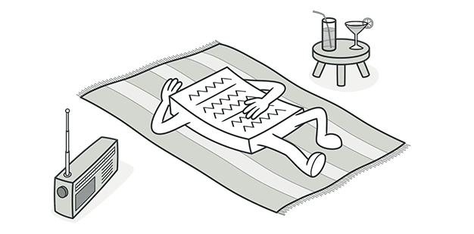
L Lazy Class
Understanding and maintaining classes always costs time and money. So if a class doesn’t do enough to earn your attention, it should be deleted.
Notes:
Reasons for the Problem
Perhaps a class was designed to be fully functional but after some of the refactoring it has become ridiculously small.
Or perhaps it was designed to support future development work that never got done.
Dispensables
A dispensable is something pointless and unneeded whose absence would make the code cleaner, more efficient and easier to understand.

Slide 19
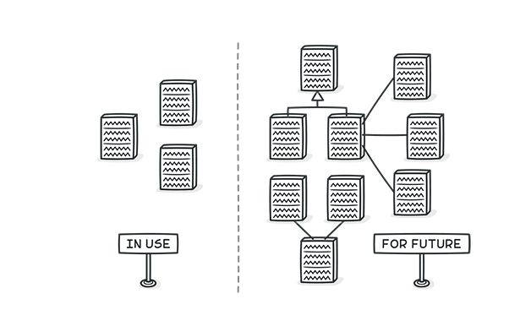
Speculative Generality
We need this functionality someday
Sometimes code is created “just in case” to support anticipated future features that never get implemented.
As a result, code becomes hard to understand and support.
Example
Notes:
Dispensables
A dispensable is something pointless and unneeded whose absence would make the code cleaner, more efficient and easier to understand.

Slide 20
Long Method
A method contains too many lines of code.
Generally, any method longer than ten lines should make you start asking questions.
Reason:
Something is always being added to a method but nothing is ever taken out.
Since it’s easier to write code than to read it, this “smell” remains unnoticed until the method turns into an ugly, oversized beast.
Notes:
Bloater

Slide 21
Long Method
Treatment:
As a rule of thumb, if you feel the need to comment on something inside a method, you should take this code and put it in a new method.
Even a single line can and should be split off into a separate method, if it requires explanations.
Notes:
Bloater

Slide 22
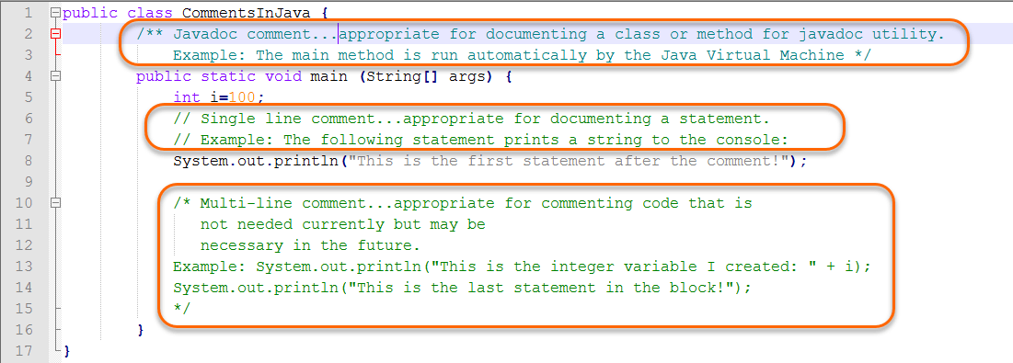
Long Method Example

Slide 23
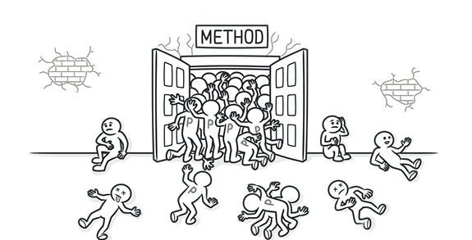
Long Parameter List
More than three or four parameters for a method.
Notes:
A long list of parameters might happen after several types of algorithms are merged in a single method. A long list may have been created to control which algorithm will be run and how.
Long parameter lists may also be the byproduct of efforts to make classes more independent of each other.
Bloater

Slide 24
Inappropriate Intimacy
Too closely coupled
Keep a close eye on classes that spend too much time together.
Good classes should know as little about each other as possible.
Such classes are easier to maintain and reuse.
Notes:
Couplers

Slide 25
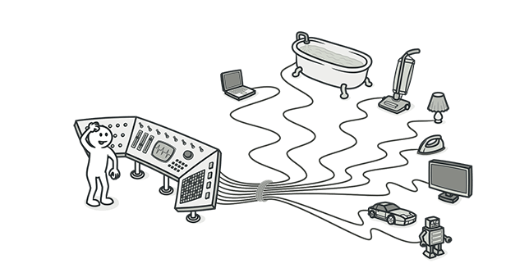
Switch Statements
You have a complex switch operator or sequence of if statements.
Notes:
Relatively rare use of switch and case operators is one of the hallmarks of object-oriented code. Often code for a single switch can be scattered in different places in the program. When a new condition is added, you have to find all the switch code and modify it.
As a rule of thumb, when you see switch you should think of polymorphism
Object orientation abusers

Slide 26
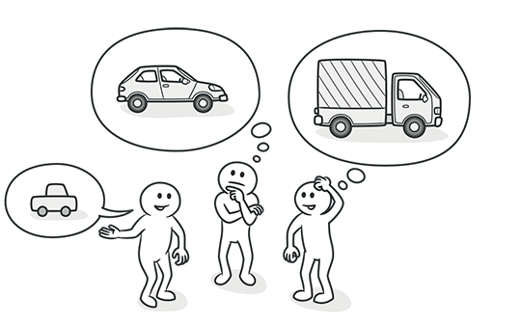
Alternative Classes with Different Interfaces
Two classes perform identical functions but have different method names.
Notes:
Object orientation abusers

Slide 27
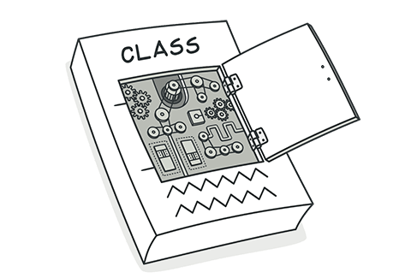
Divergent Change
You find yourself having to change many unrelated methods when you make changes to a class. For example, when adding a new product type you have to change the methods for finding, displaying, and ordering products.
Notes:
Divergent Change resembles Shotgun Surgery but is actually the opposite smell. Divergent Change is when many changes are made to a single class. Shotgun Surgery refers to when a single change is made to multiple classes simultaneously.

Slide 28
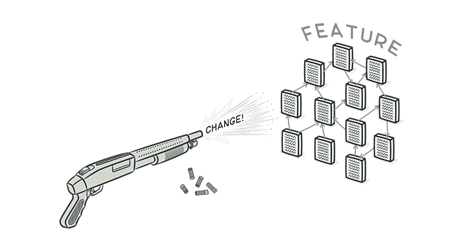
Shotgun Surgery
Shotgun Surgery refers to when a single change is made to multiple classes simultaneously.

